Slide 1


Adrian Garza
5/29/24

Slide 2

Outline
Executive Summary
Introduction
Methodology
Results
Conclusion
Appendix

Slide 3
Executive Summary
Summary of methodologies
Used a mixture of quantitative methodology and historical research in order to find the success rates of SpaceX launches across the different launch sites with varying payload sizes. This gave me a educated understanding of the trends supported by the statistical data publicly available.
Summary of all results
Discovered that Launch site KSC LC - 39A based in the kennedy space center had the highest rate of success among the launch sites, and launch site CCAFS SLC-40 had the lowest success rate among the launch sites. I also found that as the payload weight increased the rate of success decreased.

Slide 4
Introduction
Project background and context
This project took public data from the spacex websites and made a detailed analysis in order to understand the factors that influence launch success rates. By using the historical launch data, this project attempts to identify the patterns that can help inform future launches to hopefully improve success rates.
Problems you want to find answers
If different locations result in different success rates in launches.
If payload size affects the success rates of launches.
If specific rockets have a higher success rate compared to others.

Slide 5

Section 1

Slide 6
Methodology
Executive Summary
Data collection methodology:
The Data was collected through the publicly available SpaceX API
Perform data wrangling
Much of the data was in the form of IDs, and needed to be replaced by calling the API again with the IDs in order to replace it with proper data.
Perform exploratory data analysis (EDA) using visualization and SQL
Performed EDA in order to understand the distribution, relationships, and anomalies in the data using visualization tools and SQL queries.
Perform interactive visual analytics using Folium and Plotly Dash
Created interactive maps and a dashboard in order to visualize the launch locations
Perform predictive analysis using classification models
Applied machine learning classification models in order to predict the success of future SpaceX launches

Slide 7
Data Collection
Describe how data sets were collected.
You need to present your data collection process use key phrases and flowcharts
Identify Data Source
API Call
Extract IDs
Secondary API Calls
Data Cleaning and Wrangling
Data Storage

Slide 8
Data Collection – SpaceX API
Present your data collection with SpaceX REST calls using key phrases and flowcharts
Github URL: https://github.com/Yayan57/IBM-data-Science-Professional-Certificate-Capstone/blob/main/jupyter-labs-spacex-data-collection-api.ipynb
Import Libraries and Define Auxiliary Functions
Request and parse the SpaceX launch data using the GET request
Filter the dataframe to only include `Falcon 9` launches
Deal with Missing Values

Slide 9
Data Collection - Scraping
Present your web scraping process using key phrases and flowcharts
Github URL: https://github.com/Yayan57/IBM-data-Science-Professional-Certificate-Capstone/blob/main/jupyter-labs-webscraping-Copy1.ipynb
Request the Falcon9 Launch Wiki page from its URL
Extract all column/variable names from the HTML table header
Create a data frame by parsing the launch HTML tables

Slide 10
Data Wrangling
The data was wrangled by corralling it into different labels in order to better understand and work with the data.
Github URL: https://github.com/Yayan57/IBM-data-Science-Professional-Certificate-Capstone/blob/main/labs-jupyter-spacex-Data%20wrangling.ipynb
Calculate the number of launches on each site
Calculate the number and occurrence of each orbit
Calculate the number and occurence of mission outcome of the orbits
Create a landing outcome label from Outcome column

Slide 11
EDA with Data Visualization
Summarize what charts were plotted and why you used those charts
Bar chart to find the number of flights from each launch site
A bar chart to find the success rate of each orbit type
A scatter plot of flight numbers to the orbit type
A line chart with the yearly trends of launch success
I used these charts because they were determined to be the best visualization for the type of data that I wanted to analyze.
Github URL: https://github.com/Yayan57/IBM-data-Science-Professional-Certificate-Capstone/blob/main/edadataviz.ipynb

Slide 12
EDA with SQL
Using bullet point format, summarize the SQL queries you performed
Displayed the names of the unique launch sites
Displayed 5 records where launch sites begin with cca
Displayed the total payload mass launched by NASA (CRS)
Displayed average payload mass carried by booster version F9 v1.1
Listed the date when the first successful landing outcome in ground pad was achieved
Github URL: https://github.com/Yayan57/IBM-data-Science-Professional-Certificate-Capstone/blob/main/jupyter-labs-eda-sql-coursera_sqllite.ipynb

Slide 13
Build an Interactive Map with Folium
Summarize what map objects such as markers, circles, lines, etc. you created and added to a folium map
Created circles on all launch sites
Created lines from launch sites to shore, city, railway and highway
Created marker cluster to show Success and failures
Explain why you added those objects
Created these objects to show where and how close launch sites were to important locations in order to give a better visualization of the data.
Github URL: https://github.com/Yayan57/IBM-data-Science-Professional-Certificate-Capstone/blob/main/lab_jupyter_launch_site_location.ipynb

Slide 14
Build a Dashboard with Plotly Dash
Summarize what plots/graphs and interactions you have added to a dashboard
Created pie chart to show success rates of launch sites
Created Scatter point charts to show different payload rates vs. success of launch
Created drop down box to show either all locations or a specific location
Explain why you added those plots and interactions
To visualize and allow for the end user to have an easy interaction with what we believe to be important data and relationships.
Github URL: https://github.com/Yayan57/IBM-data-Science-Professional-Certificate-Capstone/blob/main/spacex_dash_app.py

Slide 15
Predictive Analysis (Classification)
Summarize how you built, evaluated, improved, and found the best performing classification model
Created a Numpy array and standardized the data
Split the data into test train split
Created objects for each classification model and calculated their accuracies
Found method which performed best (Decision Tree)
Identified the problem, Collected and cleaned data, identified patterns and correlation, visualized data
Github URL: https://github.com/Yayan57/IBM-data-Science-Professional-Certificate-Capstone/blob/main/SpaceX_Machine%20Learning%20Prediction_Part_5.ipynb

Slide 16
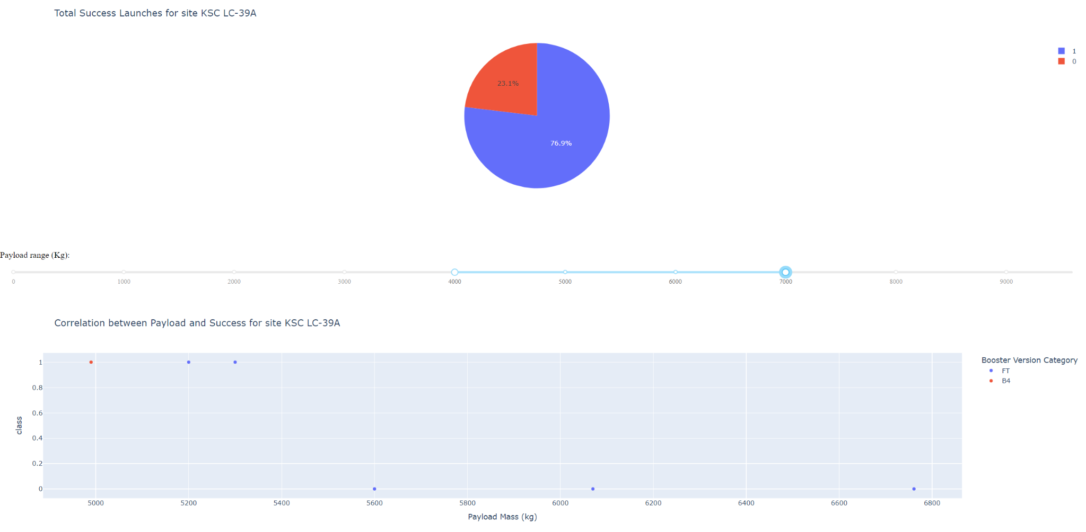
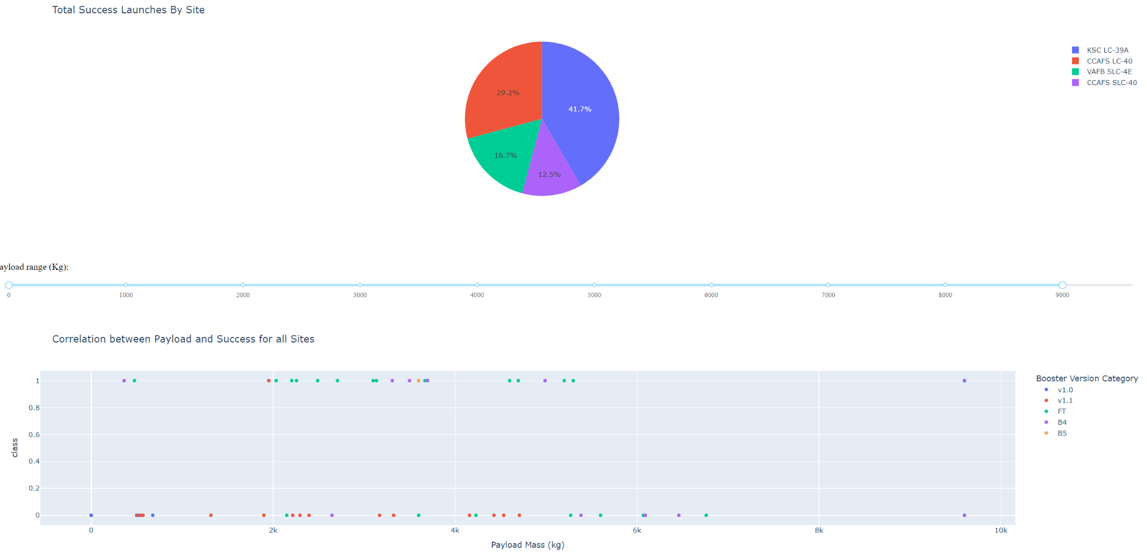
Results
Exploratory data analysis results
Found that the KSC LC - 39A launch site was the best launch site regardless of payload site
Found that Decision Tree was the best classification model
Interactive analytics demo in screenshots
Predictive analysis results
The predictive analysis results were at best 88% correct with a depth of 6

Slide 17

Section 2

Slide 18
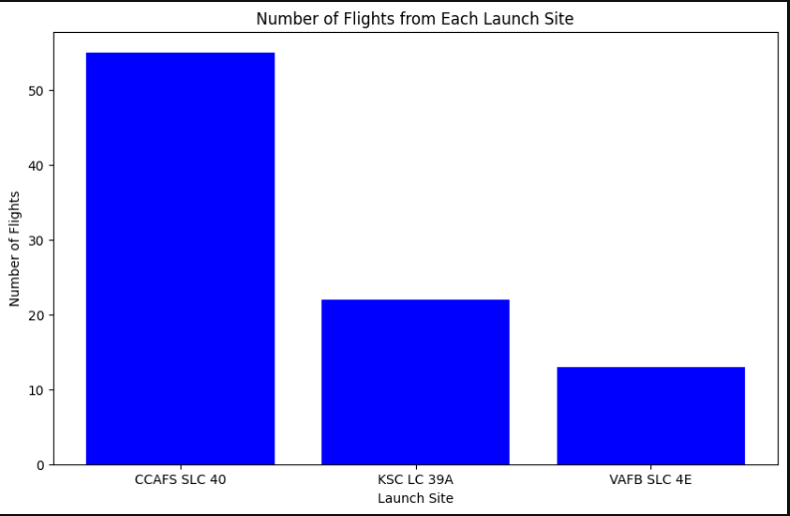
Flight Number vs. Launch Site
This shows the number of flights that were taken at each launch site.

Slide 19
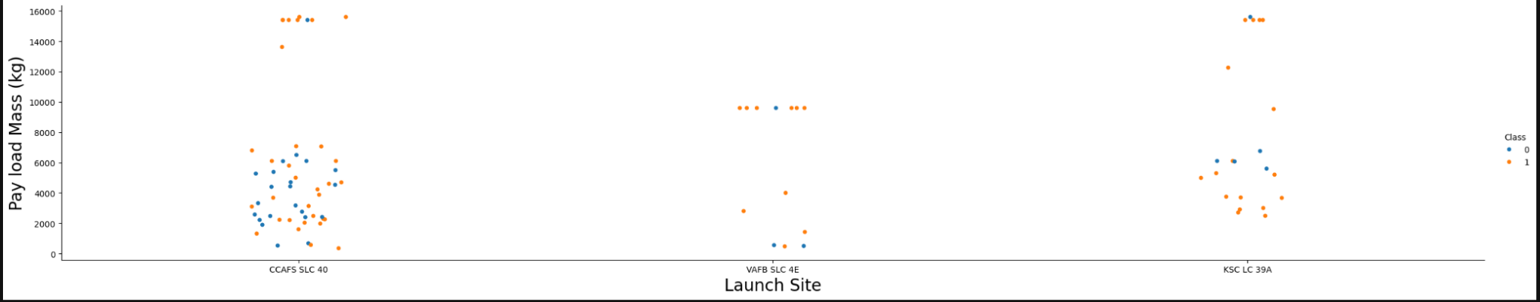
Payload vs. Launch Site
A scatter plot that shows the relationship between the launch sites and the mass of the payload in kg.

Slide 20
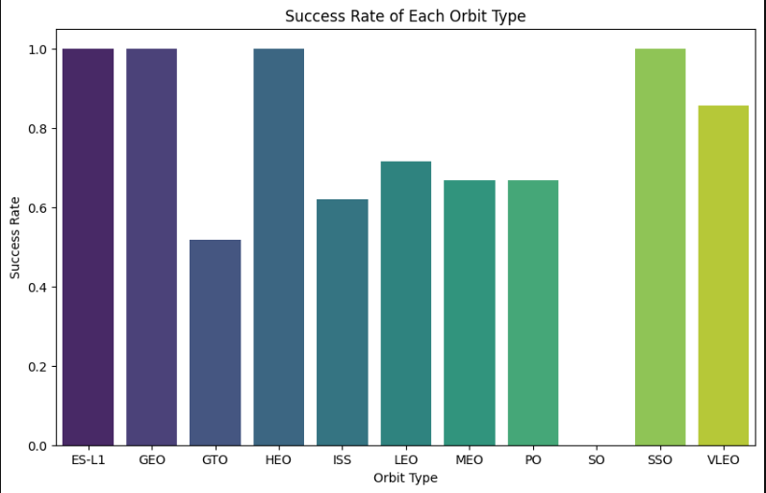
Success Rate vs. Orbit Type
A bar plot that is showing the success rate of all of the different orbit types on a scale of 0 to 1 and a interval of .2

Slide 21
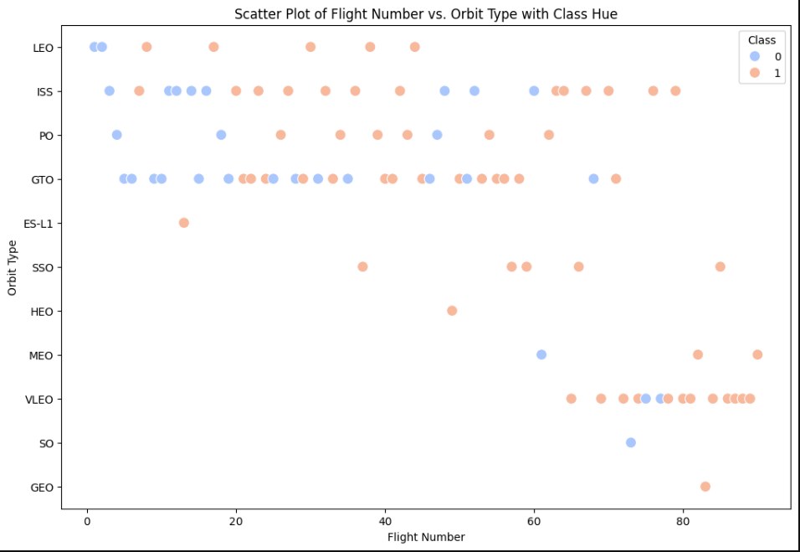
Flight Number vs. Orbit Type
A scatter plot that shows the trend of the orbit type to the flight number showing how the orbit type changes as the flight number increases.

Slide 22
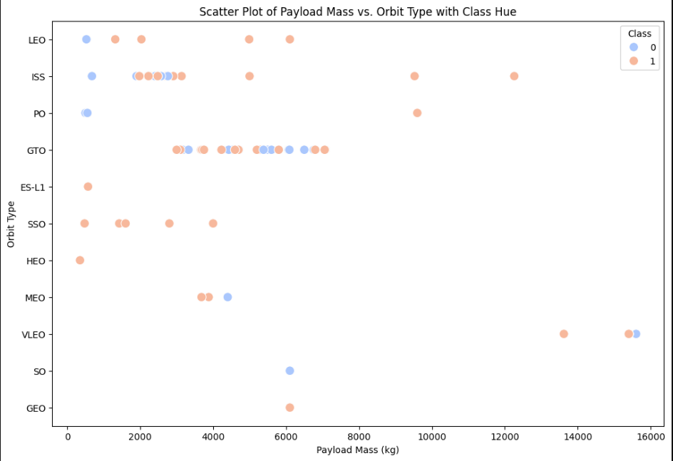
Payload vs. Orbit Type
A scatter plot that shows the relationship of the payload mass in kilograms to the type of orbit that the payload is sent towards.

Slide 23
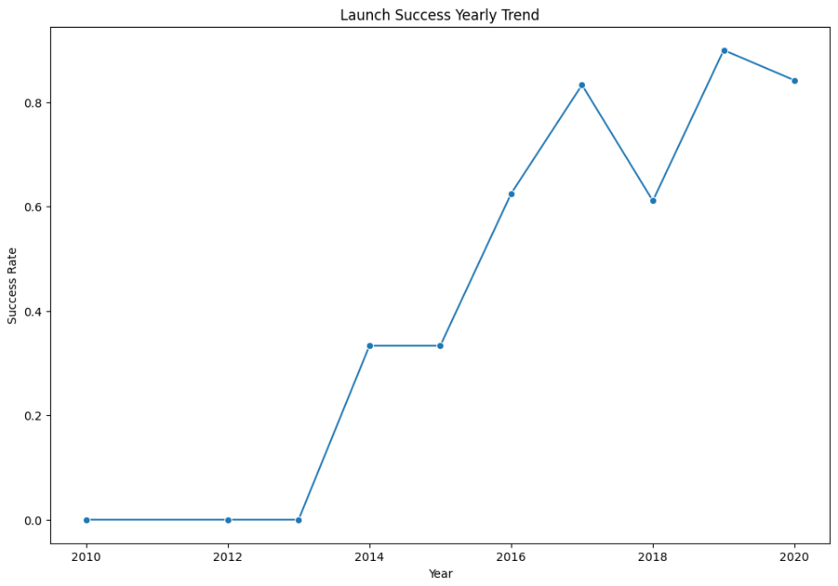
Launch Success Yearly Trend
A line plot that is showing the trend of the increasing success rate of flights to the year from 0 to 1 in intervals of .2

Slide 24
All Launch Site Names
Find the names of the unique launch sites
Present your query result with a short explanation here
%sql SELECT DISTINCT "Launch_Site" FROM SPACEXTABLE
finds all distinct launch sites from the table SPACEXTABLE
Launch_Site
CCAFS LC-40
VAFB SLC-4E
KSC LC-39A
CCAFS SLC-40

Slide 25
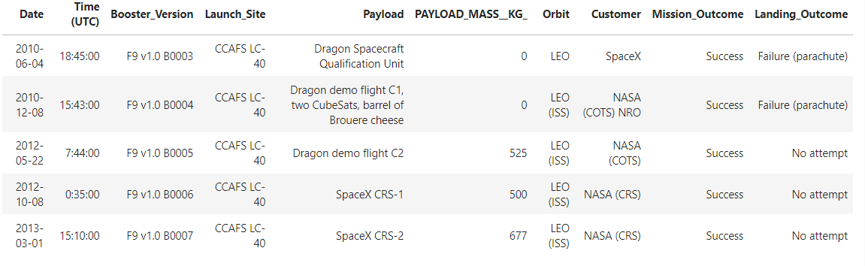
Launch Site Names Begin with 'CCA'
Find 5 records where launch sites begin with `CCA`
Present your query result with a short explanation here
%sql SELECT * FROM SPACEXTABLE WHERE "Launch_Site" LIKE 'CCA%' LIMIT 5 ;
selects the 1st 5 items from the SPACEXTABLE where the launch site starts with the characters CCA and can have any characters after that

Slide 26
Total Payload Mass
Calculate the total payload carried by boosters from NASA
Total Payload Mass: 45596
Present your query result with a short explanation here
%sql SELECT SUM("PAYLOAD_MASS__KG_") AS TotalPayloadMass FROM SPACEXTABLE WHERE "Customer" = "NASA (CRS)"
Selects all of the Payload mass rows in the table SPACEXTABLE only on the rows where the customer is set as NASA takes these rows and sums them

Slide 27
Average Payload Mass by F9 v1.1
Calculate the average payload mass carried by booster version F9 v1.1
Average Payload Mass: 2928.4
Present your query result with a short explanation here
%sql SELECT AVG("PAYLOAD_MASS__KG_") AS AveragePayloadMass FROM SPACEXTABLE WHERE "Booster_Version" = "F9 v1.1"
takes the average of all of the rows from the table SPACEXTABLE where the booster version is set to F9 v1.1

Slide 28
First Successful Ground Landing Date
Find the dates of the first successful landing outcome on ground pad
first successful landing: 2018-07-22
Present your query result with a short explanation here
%sql SELECT MIN("Date") AS FirstSuccesfulLanding FROM SPACEXTABLE WHERE "Landing_Outcome" = "Success"
finds the minimum date from the table SPACEXTABLE where the row landing outcome is set to success

Slide 29
Successful Drone Ship Landing with Payload between 4000 and 6000
List the names of boosters which have successfully landed on drone ship and had payload mass greater than 4000 but less than 6000
Booster Version: F9 FT B1022, F9 FT B1026, F9 FT B1021.2, F9 FT B1031.2
Present your query result with a short explanation here
%sql SELECT "Booster_Version" AS 'Booster Version' FROM SPACEXTABLE WHERE "Landing_Outcome" = 'Success (drone ship)' AND "PAYLOAD_MASS__KG_" > 4000 AND "PAYLOAD_MASS__KG_" < 6000
selects the booster version from the SPACEXTABLE where the landing outcome is set to success(drone ship) and the payload mass is more than 4000 lbs and less than 6000 lbs

Slide 30
Total Number of Successful and Failure Mission Outcomes
Calculate the total number of successful and failure mission outcomes
Mission Outcome: Failure (in flight) - 1, Success - 99, Success (payload status unclear) - 1
Present your query result with a short explanation here
%sql SELECT "Mission_Outcome", COUNT(*) AS Total FROM SPACEXTABLE GROUP BY "Mission_Outcome"
counts the mission outcomes from each row in SPACEXTABLE

Slide 31
Boosters Carried Maximum Payload
List the names of the booster which have carried the maximum payload mass
Booster_Version: F9 B5 B1048.4, F9 B5 B1049.4, F9 B5 B1051.3, F9 B5 B1056.4, F9 B5 B1048.5, F9 B5 B1051.4, F9 B5 B1049.5, F9 B5 B1060.2, F9 B5 B1058.3, F9 B5 B1051.6, F9 B5 B1060.3, F9 B5 B1049.7
Present your query result with a short explanation here
%sql SELECT "Booster_Version" FROM SPACEXTABLE WHERE "PAYLOAD_MASS__KG_" = (SELECT MAX("PAYLOAD_MASS__KG_") FROM SPACEXTABLE)
Selects the booster versions where the booster has carries the max payload size from the SPACEXTABLE

Slide 32
2015 Launch Records
List the failed landing_outcomes in drone ship, their booster versions, and launch site names for in year 2015
Month Landing_Outcome Booster_Version Launch_Site
January Failure (drone ship) F9 v1.1 B1012 CCAFS LC-40
April Failure (drone ship) F9 v1.1 B1015 CCAFS LC-40
Present your query result with a short explanation here
%sql SELECT CASE substr("Date", 6, 2) WHEN '01' THEN 'January' WHEN '02' THEN 'February' WHEN '03' THEN 'March' WHEN '04' THEN 'April' WHEN '05' THEN 'May' WHEN '06' THEN 'June' WHEN '07' THEN 'July' WHEN '08' THEN 'August' WHEN '09' THEN 'September' WHEN '10' THEN 'October' WHEN '11' THEN 'November' WHEN '12' THEN 'December' END AS Month, "Landing_Outcome", "Booster_Version", "Launch_Site" FROM SPACEXTABLE WHERE substr("Date", 1, 4) = '2015' AND "Landing_Outcome" = 'Failure (drone ship)';
This SQL query extracts the month name, landing outcome, booster version, and launch site from the SPACEXTABLE for records where the launch date is in the year 2015 and the landing outcome is 'Failure (drone ship)'

Slide 33
Rank Landing Outcomes Between 2010-06-04 and 2017-03-20
Rank the count of landing outcomes (such as Failure (drone ship) or Success (ground pad)) between the date 2010-06-04 and 2017-03-20, in descending order
Landing_Outcome OutcomeCount No attempt 10 Success (drone ship) 5 Failure (drone ship) 5 Success (ground pad) 3 Controlled (ocean) 3 Uncontrolled (ocean) 2 Failure (parachute) 2 Precluded (drone ship) 1
Present your query result with a short explanation here
%sql SELECT "Landing_Outcome", COUNT(*) AS OutcomeCount FROM SPACEXTABLE WHERE "Date" BETWEEN '2010-06-04' AND '2017-03-20' GROUP BY "Landing_Outcome" ORDER BY OutcomeCount DESC
selects the count of each unique landing outcome from the SPACEXTABLE for records dated between June 4, 2010, and March 20, 2017, then orders the results in descending order by the count.

Slide 34

Section 3

Slide 35
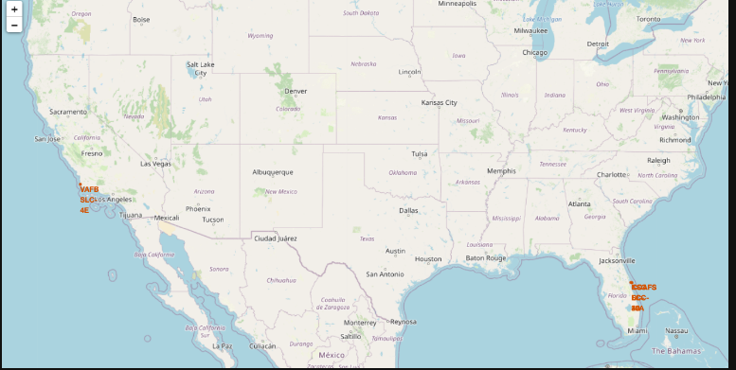
Launch Site Locations
This image shows a map of the US where the locations of the different spacex launch sites are located.

Slide 36
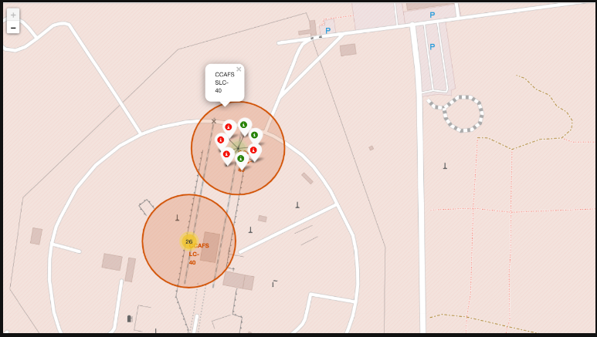
Launch Site Outcomes
Shows the outcomes of the CCAFS SLC-40 launch site.

Slide 37
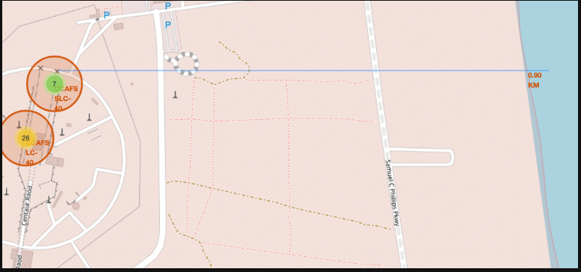
Distance from Launch Site to Shore
This image shows the distance from the launch site CCAFS SLC-40 to the shore, the distance measures to .9 kilometers.

Slide 38

Section 4

Slide 39
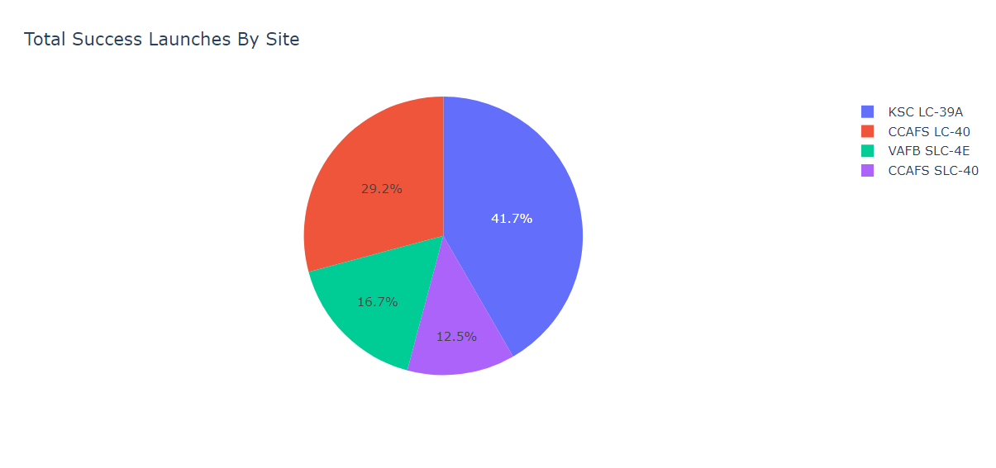
Overall Successful Launches By Site
This pie chart shows the percentages of the successful launches were done by each site

Slide 40
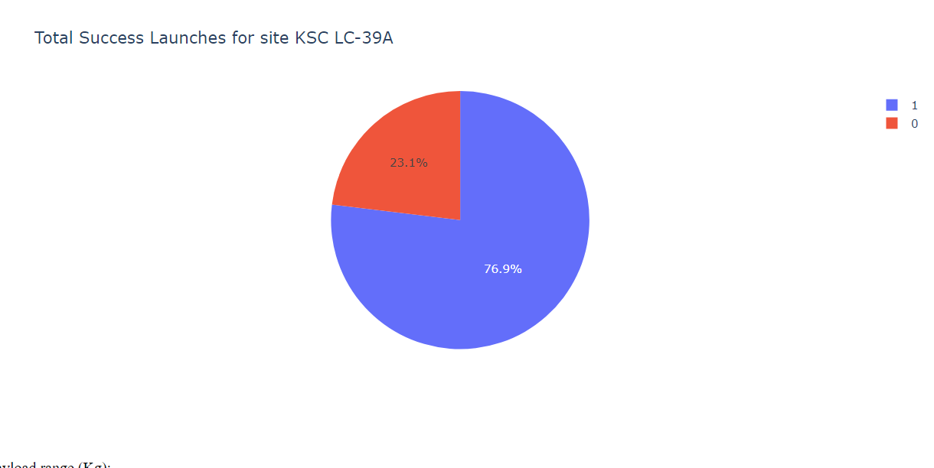
Launch Site with highest success ration
A pie chart representing the success rate of the launch site KSC LC-39A, which has the highest success rate of all of the launch sites with a success rate of 76.9

Slide 41
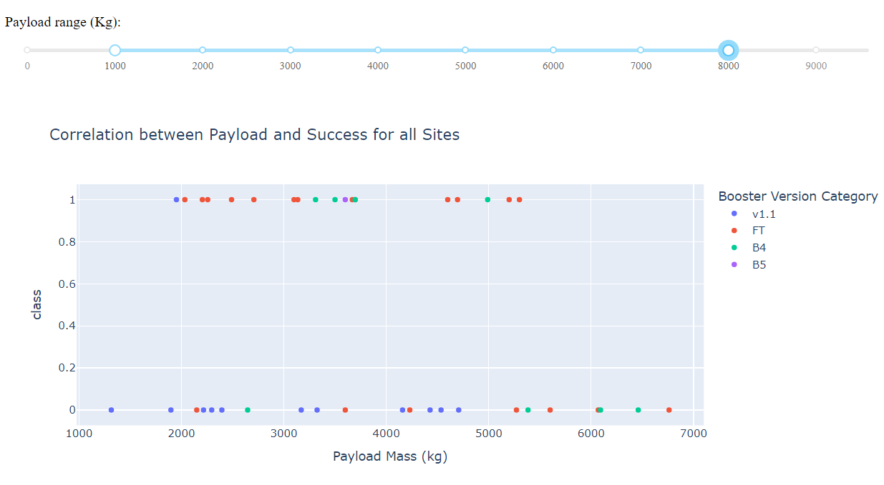
Payload vs. Launch Outcome
A scatter plot that shows the relationship between the size of the payload and the outcome of the launch, the scatter plot shows that past a certain payload size that there is not a single successful launch.

Slide 42

Section 5

Slide 43
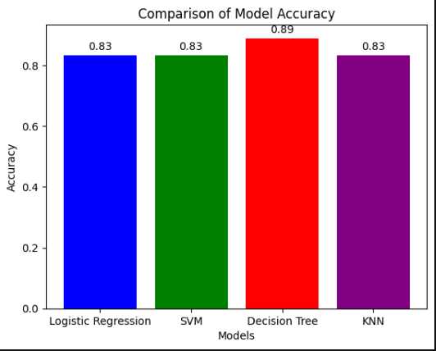
Classification Accuracy
Bar chart representing the accuracy of all of the different classification models, it was found that the decision tree was the best classification method for this particular data set.

Slide 44
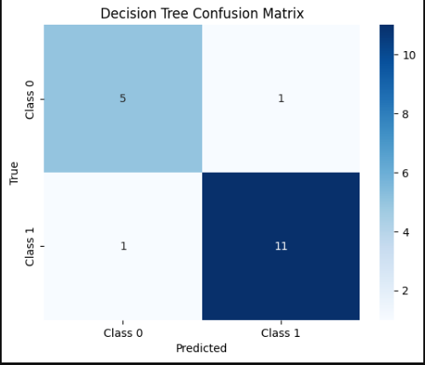
Confusion Matrix
The decision tree has the best confusion matrix because as you can see that out of the 18 cases when the class was true it predicted true in 11 out of 12 cases and when the class was false it predicted false in 5 out of 6 cases.

Slide 45
Conclusions
Conclusions:
Launch site KSC LC - 39A based in the kennedy space center had the highest rate of success among the launch sites
As the payload weight increased the rate of success decreased
Decision Tree was the best classification model
…

Slide 46
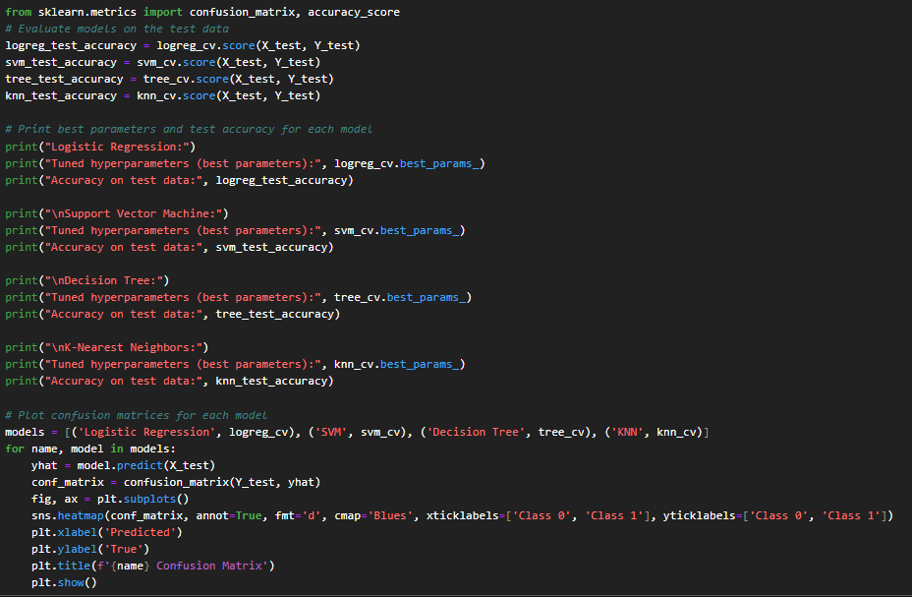
Appendix
Completed tasks and created functions in python as needed to meet the requirements of all labs and tasks in said labs. Example of completed task.

Slide 47


